Slide 1

Direction of Arrival Estimation
by Sparse Arrays
Alp GÜRSOY
Advisor: Prof. Tolga ÇİLOĞLU
December 19, 2025

Slide 2

Content
Direction of Arrival (DOA)
Signal Model
Classical DOA Estimation Methods
MUSIC
Comparison
Sparse Arrays
Difference Coarray
Nested Array (NA)
Coprime Array (CA)
Signal Coherence
Spatial Smoothing
Toeplitz Completion
Nuclear Norm Minimization
Deep Learning
Conclusion

Slide 3
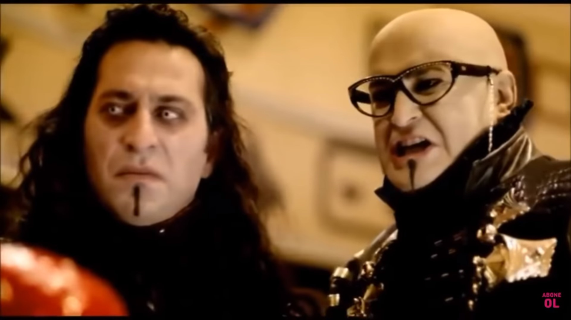
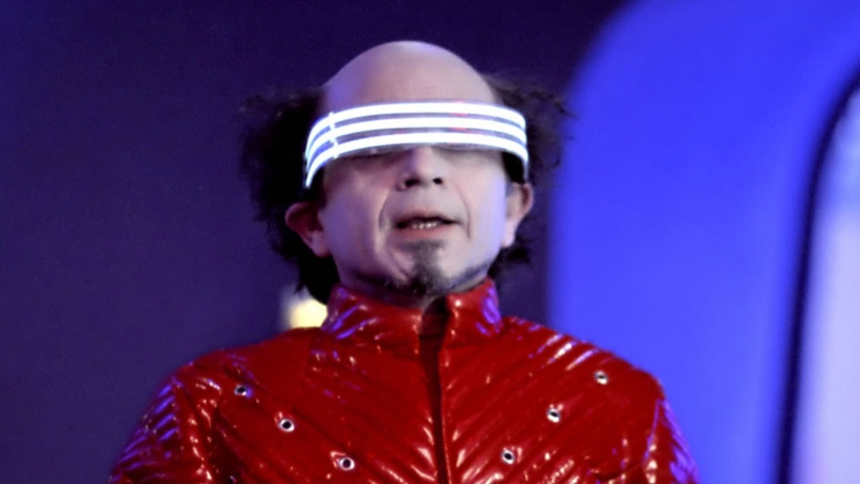
Direction of Arrival
What is Direction of Arrival (DOA) Estimation About?
‘‘An object is approaching!’’

Slide 4
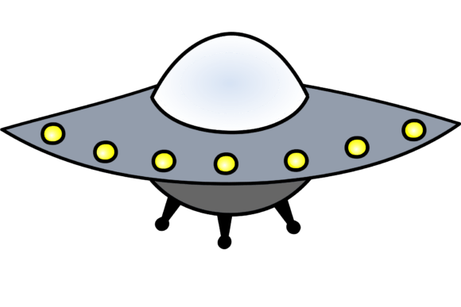
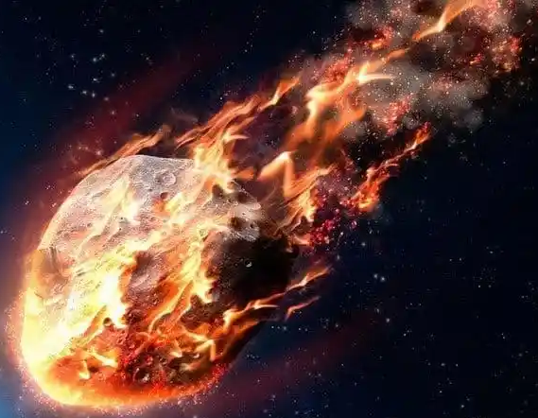
Direction of Arrival
What is Direction of Arrival (DOA) Estimation About?

Slide 5
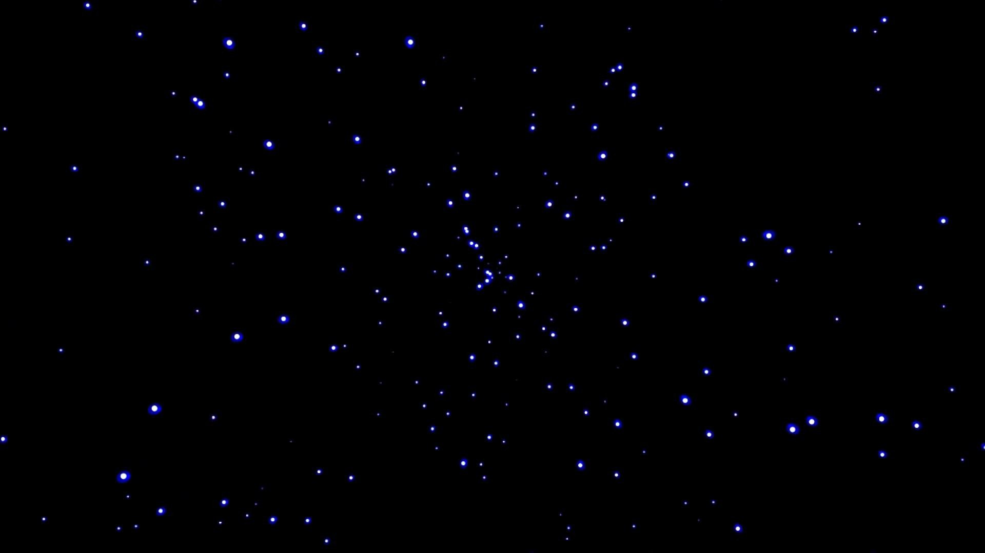
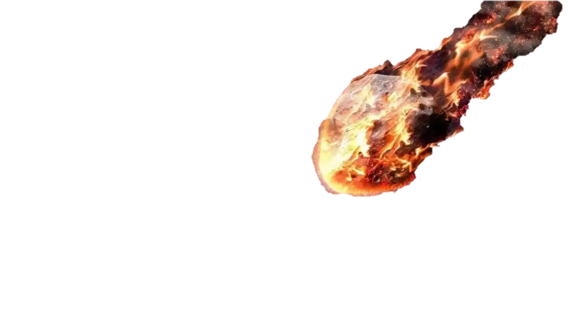


Direction of Arrival
What is Direction of Arrival (DOA) Estimation About?

Slide 6
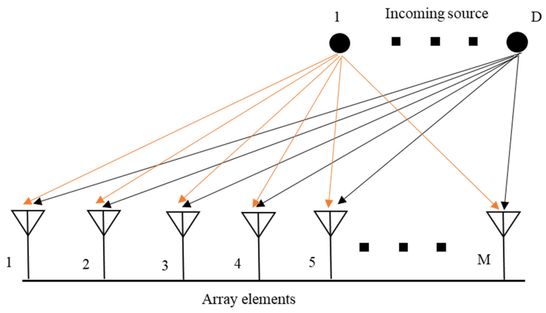
Direction of Arrival Estimation
What is Direction of Arrival (DOA) Estimation About?
K

Slide 7
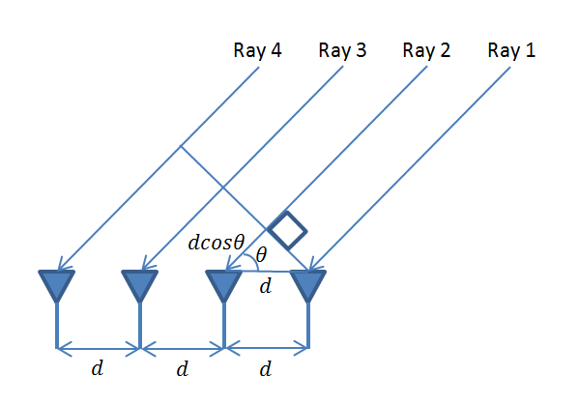

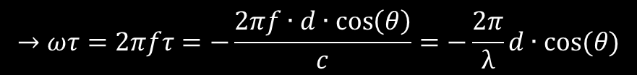
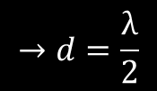
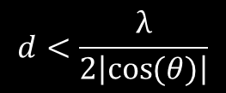
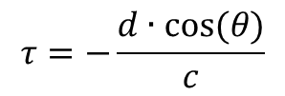
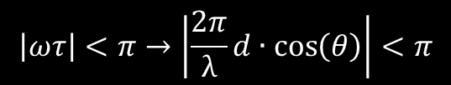
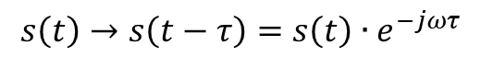
Signal Model
Narrowband Signal Assumption
K
$$→ωτ=2πfτ=−\frac{2πf∙d∙\cos\left(θ\right)}{c}=−\frac{2π}{\text{λ}}d∙cos⁡(θ)$$
$$\left|ωτ\right|<π→\left|\frac{2π}{\text{λ}}d∙\cos\left(θ\right)\right|<π$$
$$d<\frac{\text{λ}}{2\left|\cos{(θ)}\right|}$$
$$s\left(t\right)→s\left(t−τ\right)=s\left(t\right)∙e^{−jωτ}$$
$$→d=\frac{\text{λ}}{2}$$
$$τ=−\frac{d∙cos⁡(θ)}{c}$$

Slide 8
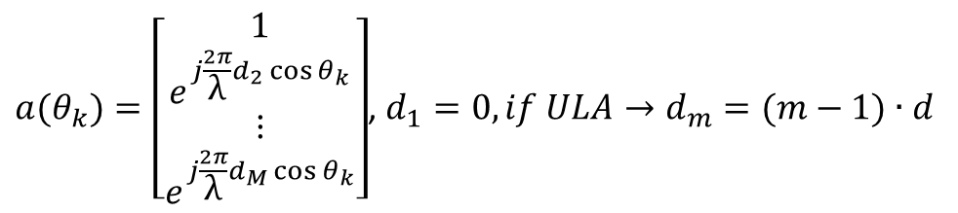
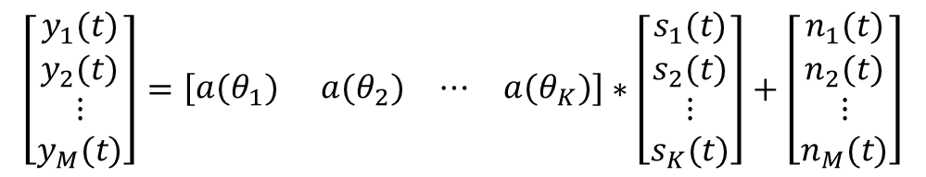
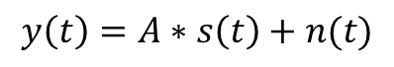
Signal Model
K
Matrix Representation of DOA Estimation
$$y\left(t\right)=A∗s\left(t\right)+n(t)$$
$$\left[\begin{matrix}\begin{matrix}y_{1}(t) \\ y_{2}(t)\end{matrix} \\ \begin{matrix}⋮ \\ y_{M}(t)\end{matrix}\end{matrix}\right]=\left[\begin{matrix}\begin{matrix}a(θ_{1}) & a(θ_{2})\end{matrix} & \begin{matrix}⋯ & a(θ_{K})\end{matrix}\end{matrix}\right]∗\left[\begin{matrix}\begin{matrix}s_{1}(t) \\ s_{2}(t)\end{matrix} \\ \begin{matrix}⋮ \\ s_{K}(t)\end{matrix}\end{matrix}\right]+\left[\begin{matrix}\begin{matrix}n_{1}(t) \\ n_{2}(t)\end{matrix} \\ \begin{matrix}⋮ \\ n_{M}(t)\end{matrix}\end{matrix}\right]$$
$a(θ_{k})=\left[\begin{matrix}\begin{matrix}1 \\ e^{j\frac{2π}{\text{λ}}d_{2}\cos{θ_{k}}}\end{matrix} \\ \begin{matrix}⋮ \\ e^{j\frac{2π}{\text{λ}}d_{M}\cos{θ_{k}}}\end{matrix}\end{matrix}\right]$, $d_{1}=0,if ULA→d_{m}=(m−1)∙d$

Slide 9
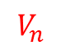
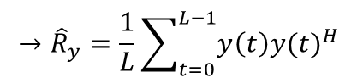
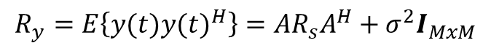
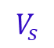
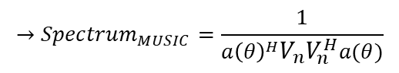
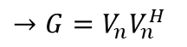
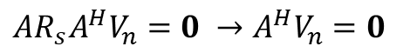
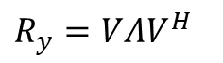
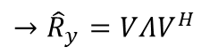
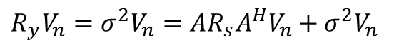
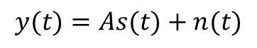
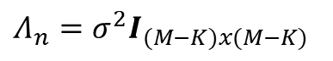
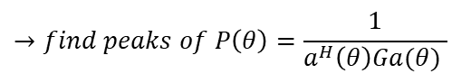
DOA Estimation Methods
MUSIC (Multiple Signal Classification)
$$y(t)=As(t)+n(t)$$
The Algorithm:
$$R_{y}=E\left\{y(t){y(t)}^{H}\right\}=AR_{s}A^{H}+σ^{2}I_{MxM}$$
$$R_{y}=VΛV^{H}$$
$$→{\hat{R}}_{y}=\frac{1}{L}\sum_{t=0}^{L−1}{y\left(t\right){y(t)}^{H}}$$
$$V=\left[\begin{matrix}\begin{matrix}\begin{matrix}v_{1} & v_{2}\end{matrix} & \begin{matrix}⋯ & v_{K}\end{matrix}\end{matrix} & \begin{matrix}\begin{matrix}v_{K+1} & v_{K+2}\end{matrix} & \begin{matrix}⋯ & v_{M}\end{matrix}\end{matrix}\end{matrix}\right]$$
$$→{\hat{R}}_{y}=VΛV^{H}$$
$$V_{s}$$
$$V_{n}$$
$$→G=V_{n}V_{n}^{H}$$
$$Λ_{n}=σ^{2}I_{(M−K)x(M−K)}$$
$$→find peaks of P\left(θ\right)=\frac{1}{a^{H}\left(θ\right)Ga(θ) }$$
$$R_{y}V_{n}=σ^{2}V_{n}=AR_{s}A^{H}V_{n}+σ^{2}V_{n}$$
$$AR_{s}A^{H}V_{n}=0 →A^{H}V_{n}=0$$
$$→{Spectrum}_{MUSIC}=\frac{1}{{a\left(θ\right)}^{H}V_{n}V_{n}^{H}a(θ)}$$

Slide 10
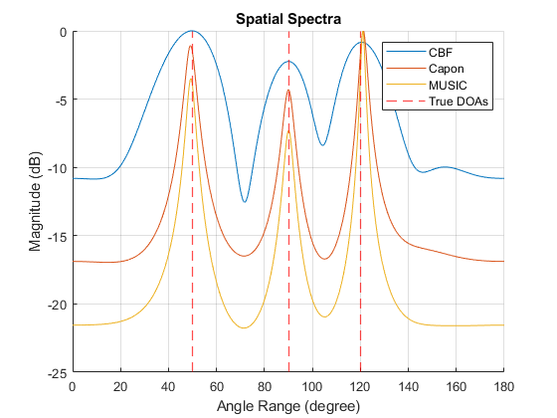
DOA Estimation Methods

Slide 11
Sparse Arrays
Why Sparse Sensor Arrays?
- Using equal number of sensors results in a larger aperture.
ULA
D = 4
SLA
D = 9
- Fewer number of sensors are needed to achieve the same aperture of ULA.
ULA
M = 10
SLA
M = 5
- SLA is affected by mutual coupling less compared to ULA.
ULA
# Close Sensor Pairs = 4
SLA
# Close Sensor Pairs = 1

Slide 12
Sparse Array Types
Difference Co-array
0
1
2
3
4
5
6
7
8
9
$$\left[1 1 1 1 1 1 2 1 1 5 1 1 2 1 1 1 1 1 1\right]$$
lag values:
-9 -8 -7 -6 -5 -4 -3 -2 -1 0 1 2 3 4 5 6 7 8 9
Virtual Array
-9
-8
-7
-6
-5
-4
-3
-2
-1
0
1
2
3
4
5
6
7
8
9

Slide 13
Sparse Array Types
2-Level Nested Array (NA)
1
2
3
4
5
6
7
8
9
10
11
12
Difference Co-array:
$$\left[1 1 1 1 1 1 1 2 1 2 3 6 3 2 1 2 1 1 1 1 1 1 1\right]$$
Virtual Array of the Nested Array:
-11
-10
-9
-8
-7
-6
-5
-4
-3
-2
-1
0
1
2
3
4
5
6
7
8
9
10
11

Slide 14
Sparse Array Types
Coprime Array (CA)
0
1
2
3
4
5
6
7
8
9
Difference Co-array:
$$\left[1 1 0 2 1 2 3 2 2 6 2 2 3 2 1 2 0 1 1\right]$$
(CA)
-9
-8
-7
-6
-5
-4
-3
-2
-1
0
1
2
3
4
5
6
7
8
9
Difference Co-array:
$$\left[1 1 1 1 1 1 1 2 1 2 3 6 3 2 1 2 1 1 1 1 1 1 1\right]$$
(NA)
-11
-10
-9
-8
-7
-6
-5
-4
-3
-2
-1
0
1
2
3
4
5
6
7
8
9
10
11

Slide 15
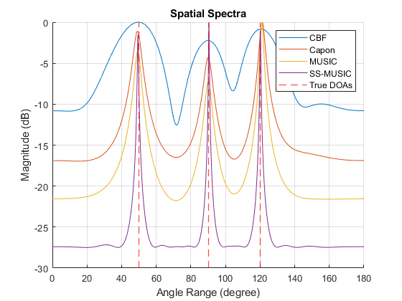
Sparse Array Types

Slide 16
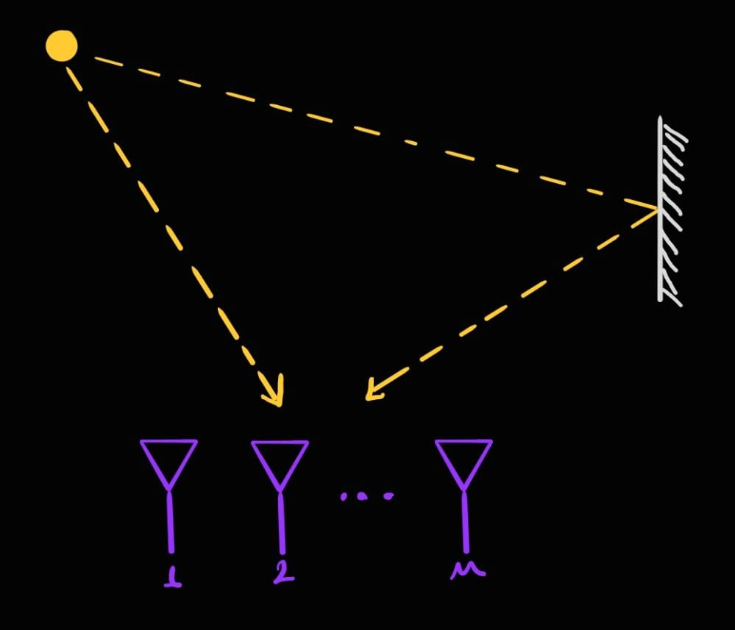
DOA Estimation of Coherent Signals

Slide 17
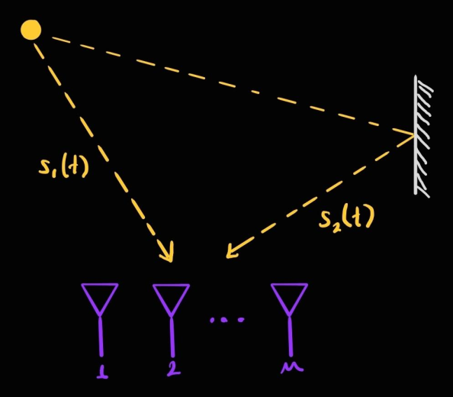
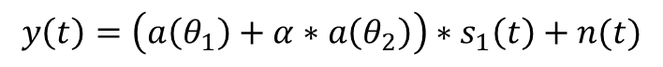
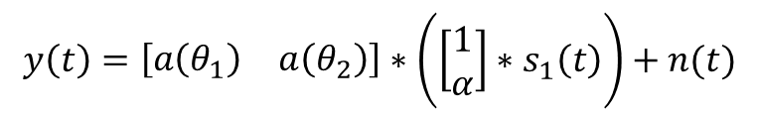
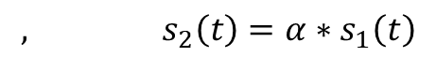
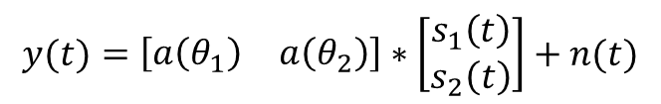
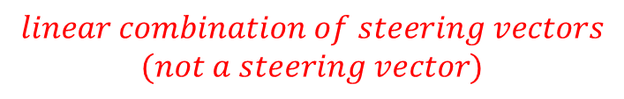
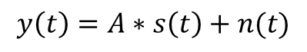
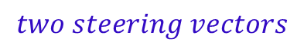
DOA Estimation of Coherent Signals
Signal Model
$$y\left(t\right)=A∗s\left(t\right)+n(t)$$
$$y(t)=\left[\begin{matrix}a\left(θ_{1}\right) & a\left(θ_{2}\right)\end{matrix}\right]∗\left[\begin{matrix}s_{1}\left(t\right) \\ s_{2}\left(t\right)\end{matrix}\right]+n(t)$$
$$, s_{2}\left(t\right)=α∗s_{1}\left(t\right)$$
$$two steering vectors$$
$$y\left(t\right)=\left[\begin{matrix}a\left(θ_{1}\right) & a\left(θ_{2}\right)\end{matrix}\right]∗\left(\left[\begin{matrix}1 \\ α\end{matrix}\right]∗s_{1}\left(t\right)\right)+n(t)$$
$$y\left(t\right)=\left(a\left(θ_{1}\right)+α∗a\left(θ_{2}\right)\right)∗s_{1}\left(t\right)+n(t)$$
$$linear combination of steering vectors$$
$$(not a steering vector)$$

Slide 18
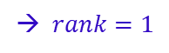
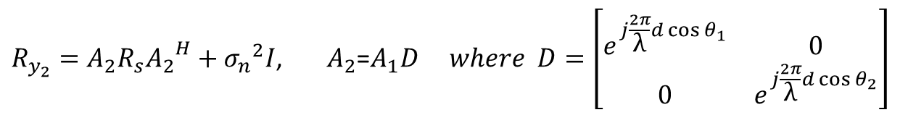
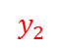
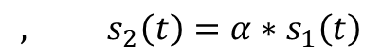
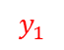
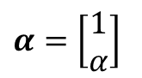
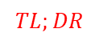
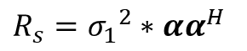
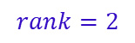
DOA Estimation of Coherent Signals
Spatial Smoothing
$$y_{1}$$
0
1
2
3
4
5
6
7
8
9
$$y_{2}$$
$$α=\left[\begin{matrix}1 \\ α\end{matrix}\right]$$
$$, s_{2}\left(t\right)=α∗s_{1}\left(t\right)$$
$$R_{s}={σ_{1}}^{2}∗αα^{H}$$
→ $rank=1$
$$R_{y_{1}}=A_{1}R_{s}{A_{1}}^{H}+{σ_{n}}^{2}I\text{, }A_{1}\text{=}\left[\begin{matrix}a\left(θ_{1}\right) & a\left(θ_{2}\right)\end{matrix}\right]$$
$R_{y_{2}}=A_{2}R_{s}{A_{2}}^{H}+{σ_{n}}^{2}I$, $A_{2}$=$A_{1}D where D=\left[\begin{matrix}e^{j\frac{2π}{\text{λ}}d\cos{θ_{1}}} & 0 \\ 0 & e^{j\frac{2π}{\text{λ}}d\cos{θ_{2}}}\end{matrix}\right]$
$$R_{ss}=\frac{1}{2} (R_{y_{1}}+R_{y_{2}})=A_{1}\left[\frac{1}{2}(R_{s}+DR_{s}D^{H})\right]{A_{1}}^{H}+{σ_{n}}^{2}I$$
$$TL;DR$$
$$rank=2$$

Slide 19








DOA Estimation of Coherent Signals
Toeplitz Completion (Using The Difference Coarray)
1
2
3
4
5
6
7
8
9
10
11
12
-11
-10
-9
-8
-7
-6
-5
-4
-3
-2
-1
0
1
2
3
4
5
6
7
8
9
10
11
$$α=\left[\begin{matrix}1 \\ α\end{matrix}\right]$$
$$, s_{2}\left(t\right)=α∗s_{1}\left(t\right)$$
$$R_{s}={σ_{1}}^{2}∗αα^{H}$$
→ $rank=1 and not a diagonal matrix$
$$R_{y}=AR_{s}A^{H}+{σ_{n}}^{2}I$$
→ $does not have a toeplitz structure$
$$R_{y}→R_{virtual}$$
→ $has a toeplitz structure$

Slide 20


DOA Estimation of Coherent Signals
Toeplitz Completion (Using The Difference Coarray)
1
2
3
4
5
6
7
8
9
10
11
12
-11
-10
-9
-8
-7
-6
-5
-4
-3
-2
-1
0
1
2
3
4
5
6
7
8
9
10
11

Slide 21


DOA Estimation of Coherent Signals
Nuclear Norm Minimization (Utilizing The Difference Coarray)
0
1
2
3
4
5
6
7
8
9
-9
-8
-7
-6
-5
-4
-3
-2
-1
0
1
2
3
4
5
6
7
8
9
$$minimize the nuclear norm of R_{virtual} by filling the holes$$
$$convex surrogate for matrix rank (which is nonconvex)$$

Slide 22

DOA Estimation of Coherent Signals
Deep Learning

Slide 23

DOA Estimation of Coherent Signals

Slide 24
Conclusion
To conclude,
Compared to ULAs, sparse arrays are superior in terms of
aperture,
mutual coupling.
Traditional DOA estimation methods have difficulties dealing with coherent signals. Combined with different kinds of methods, sparse arrays can be useful at addressing the coherence problem.

Slide 25

Thank you for your attention.

